Slide 1
When should humans overrule AI?
Monica

Slide 2
Artificial General Intelligence (AGI)
Types of AI
Artificial Superintelligence (ASI)
Artificial Narrow Intelligence (ANI)
Has a narrow range of abilities;
Operate under a narrow set of constraints and limitations
Eg: Siri , Image / facial recognition software
Artificial super intelligence (ASI), is the hypothetical AI that doesn’t just mimic or understand human intelligence and behaviour; ASI is where machines become self-aware and surpass the capacity of human intelligence and ability.
Is on par with human capabilities
AGI can think, understand, and act in a way that is indistinguishable from that of a human in any given situation.
Eg: Self-driving cars

Slide 3
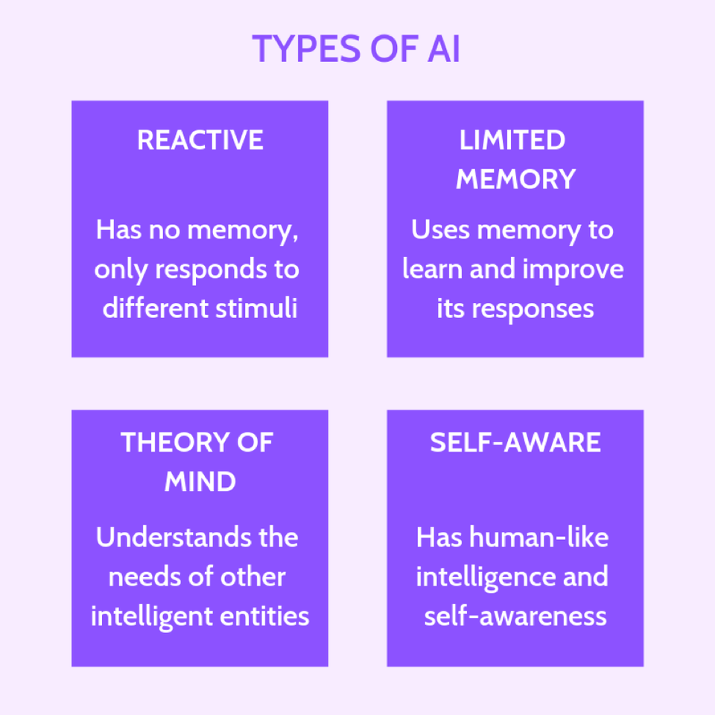
Types of AI

Slide 4
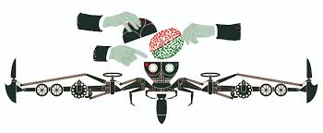
When should humans overrule AI?
Lethal autonomous weapon system
Treatment (radiation treatment )
Autonomous system to remain under meaningful human control – guidance control
Runtime - make a plan/decide and execute it.
Machines can’t think like a human being
The well-being of the public

Slide 5
When should humans overrule AI?
Requires using judgment on-the-fly (Boeing 737 crash)
Predicting the future
Dynamic instability
It might impact the rights of citizens
Automated decisions are biased (garbage in garbage out)
The Human Machine Interface (HMI) is a key matter to the co-sharing arrangement.
We should only use algorithms as long as we can trust humans to overrule them when necessary – Hannah Fry.

Slide 6
Interesting !
In his book Superintelligence, Nick Bostrom begins with
“The Unfinished Fable of the Sparrows.”
Basically, some sparrows decided they wanted a pet owl. Most sparrows thought the idea was awesome, but one was sceptical, voicing concern about how the sparrows could control an owl. This concern was dismissed in a “we’ll deal with that problem when it’s a problem” matter.
THANK YOU

